Slide 1
Remaining part chapter 7

Slide 2
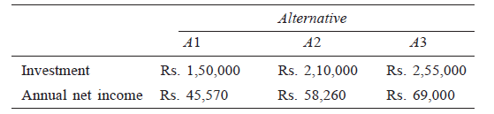
Example 3
A firm has identified three mutually exclusive investment proposals whose details are given below. The life of all the three alternatives is estimated to be five years with negligible salvage value. The minimum attractive rate of return for the firm is 12%.
Find the best alternative based on the rate of return method of comparison.

Slide 3
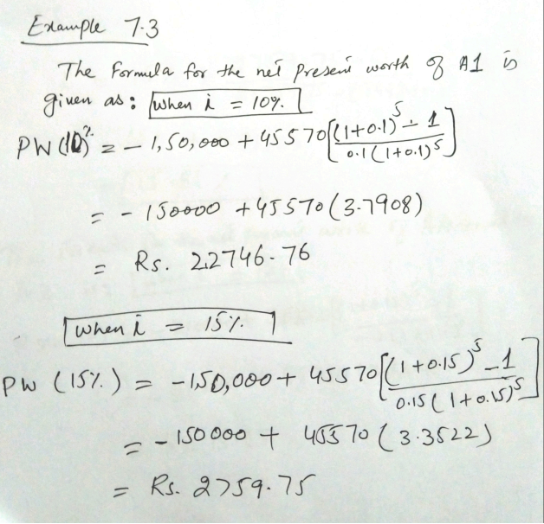

Slide 4
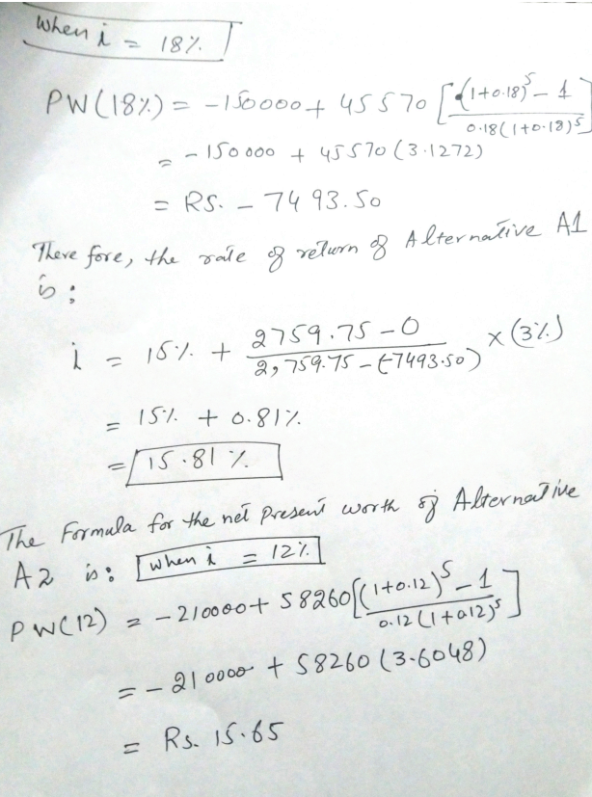

Slide 5
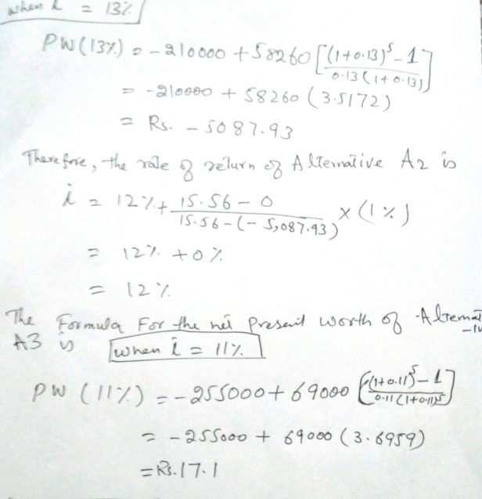

Slide 6


Slide 7
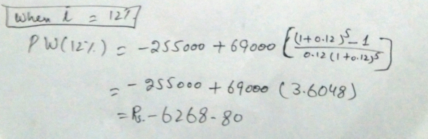
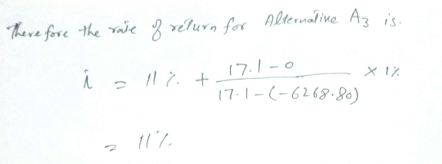

Slide 8
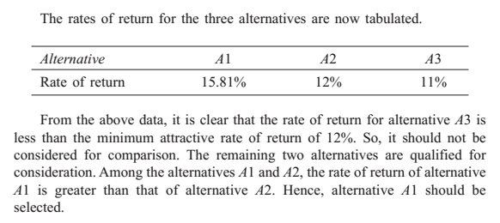

Slide 9
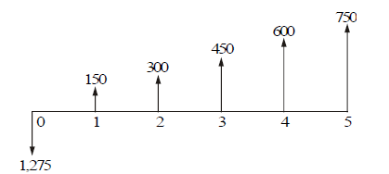
Example 4
For the cash flow diagram shown in the Figure, compute the rate of return. The amounts are in rupees.

Slide 10
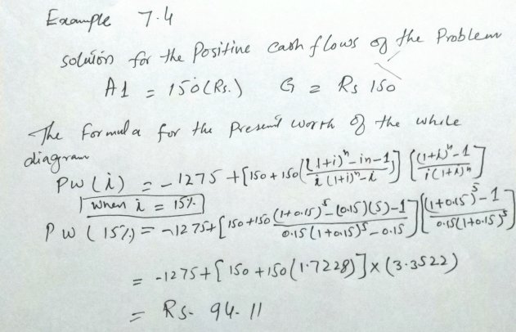

Slide 11
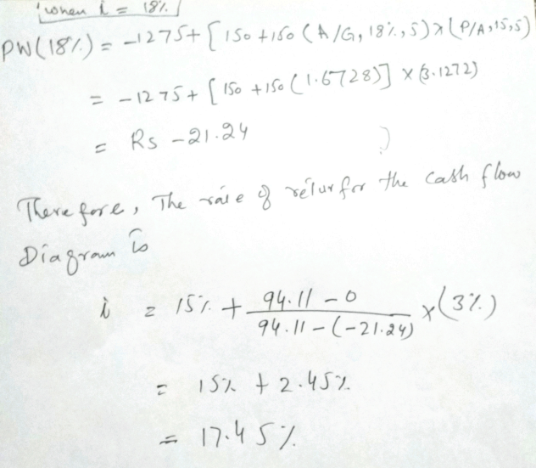

Slide 12
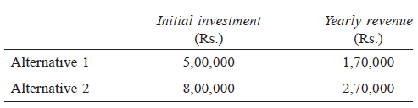
Example 5
A company is planning to expand its present business activity. It has two alternatives for the expansion programme and the corresponding cash flows are tabulated below. Each alternative has a life of five years and a negligible salvage value. The minimum attractive rate of return for the company is 12%. Suggest the best alternative to the company.

Slide 13
The End

